Slide 1
Course project final report: Generating Panoramic Image
CS5240 Theoretical Foundations in Multimedia
School of Computing, NUS
Presented by: Group P04
Members: Cao Qi, Wang Qinyi, Zhang Chen, Zhao Yuan
Nov. 16, 2019

Slide 2
OUTLINE
Project Objective
Problem Formulation
Problem Definition
Algorithm
Summary
Notes:
Our presentation today will be divided into 4 main parts.
First of all, I will give you some background information for our project.
And state the objective of our project.
Then, I will present the problem formulation of our project.
Zhao Yuan will continue to describe the formal problem definition of our project.
After that, Zhang Chen will introduce the algorithms we developed for our project.
And lastly, Cao Qi will give in depth explanations about the function and algorithm we used in our project and draw a conclusion.

Slide 3
PROJECT OBJECTIVE

Slide 4
PROJECT OBJECTIVE
Point 1
Point 2
Point 3

Slide 5
PROBLEM FORMULATION

Slide 6
PROBLEM FORMULATION
Point 1
Point 2
Point 3
Notes:
Traditional automatic speech recognition (ASR) systems are comprised of an acoustic model (AM), a language model (LM), and a pronunciation lexicon.
All of these components are independently trained, and often manually designed, on different datasets
AMs take acoustic features and predict a set of subword units, typically context-dependent or context-independent phonemes.
Next, a hand-designed lexicon (the PM) maps a sequence of phonemes produced by the acoustic model to words.
Finally, the LM assigns probabilities to word sequences.
The above modules are optimized separately with different objectives, which may result in incoherence in optimization, where each module is not trained to match the other modules.
Decoding has to be performed by integrating all modules. Although this integration is often efficiently handled by finite state transducers, the construction and implementation of well-optimized transducers are very complicated
To factorize acoustic and language models well, we need to have a lexicon model to map word to phoneme sequences. phonemes are designed using linguistic knowledge, they are subject to human error that a fully data-driven system might avoid.
attention-based methods use an attention mechanism to perform alignment between acoustic frames and recognized symbols
connectionist temporal classification (CTC) uses Markov assumptions to efficiently solve sequential problems by dynamic programming

Slide 7
PROBLEM DEFINITION
Notes:
Now lets move to the conclusion part

Slide 8
PROBLEM DEFINITION
Point 1
Point 2
Point 3

Slide 9
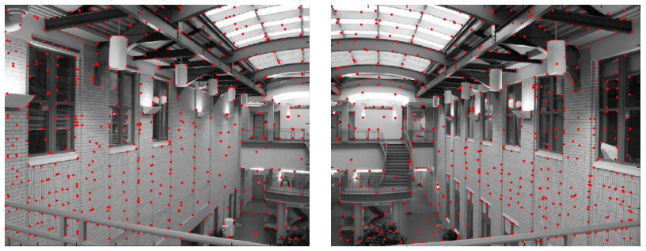
Alignment Algorithm
Give images A and B with features
Match features between A and B
Compute homography between A and B using least squares on the set of matches

Slide 10
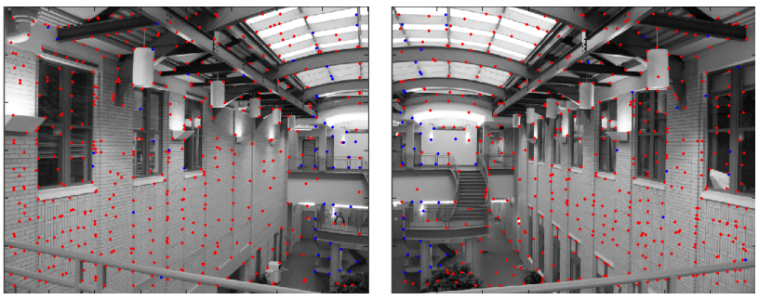

outlier rejection
Not match all features, but only these that have “similar enough” matches
min$\left\|u_{i}−v_{j} \right\|<threshold$
Still too many outliers

Slide 11
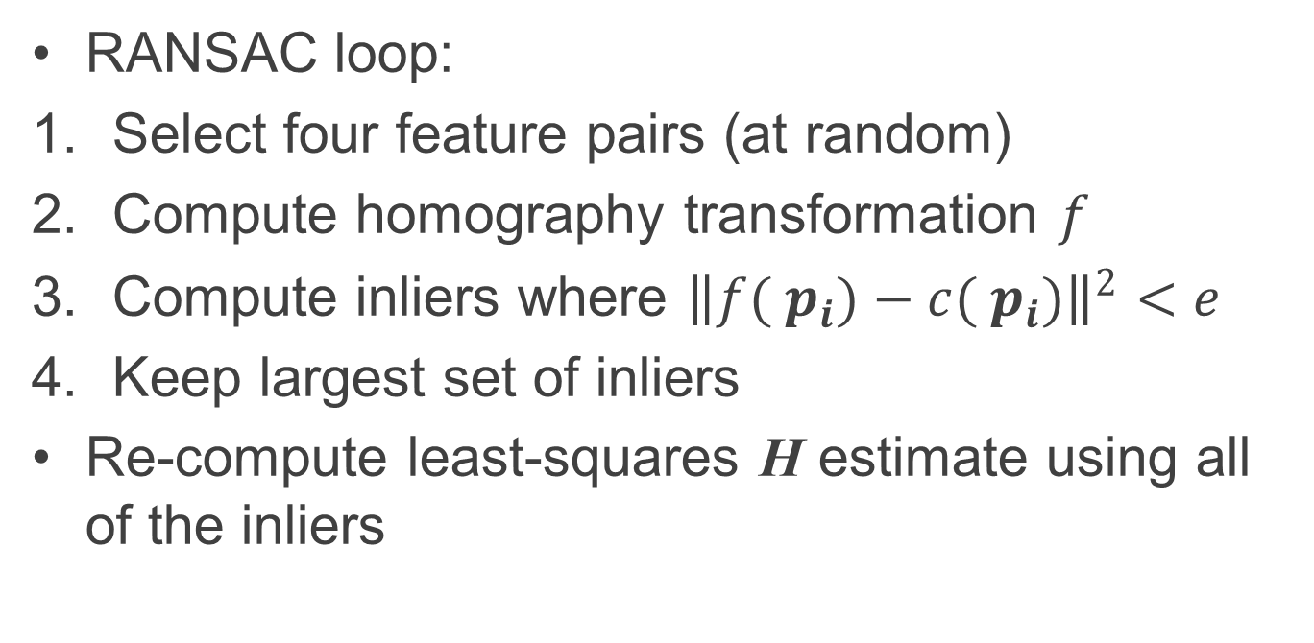
RANSAC
RANSAC loop:
Select four feature pairs (at random)
Compute homography transformation $f$
Compute inliers where ${\left\|f( p_{i})−c( p_{i})\right\|}^{2}<e$
Keep largest set of inliers
Re-compute least-squares H estimate using all of the inliers

Slide 12
RANSAC
Select four feature pairs randomly
Compute homography H and count inliers

Slide 13
RANSAC
Keep largest set of liners

Slide 14
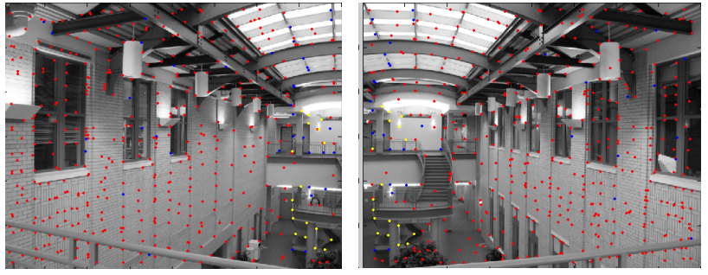
RANSAC
Red points: no match
Blue points: “good” match but outliers
Yellow points: correct match (the largest set)

Slide 15
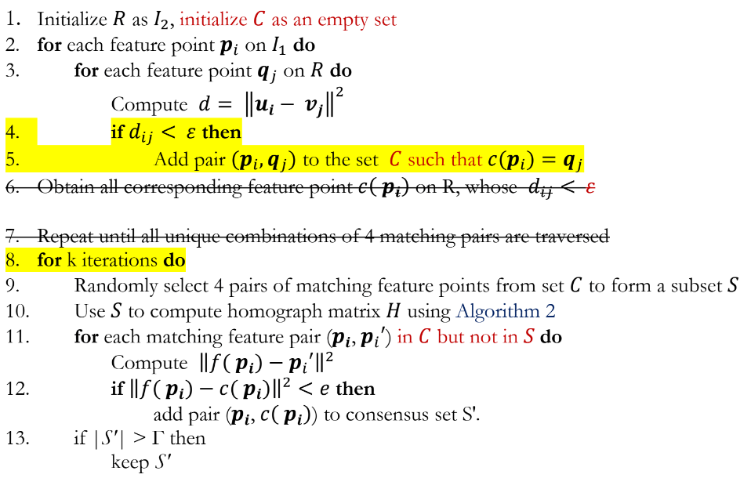
Algorithm

Slide 16
ALGORITHM

Slide 17
ALGORITHM 1
Point 1
Point 2
Point 3

Slide 18
ALGORITHM 2
Point 1
Point 2
Point 3

Slide 19
EXPLANATION 1
Point 1
Point 2
Point 3

Slide 20
EXPLANATION 2
Point 1
Point 2
Point 3

Slide 21
SUMMARY

Slide 22
SUMMARY
Point 1
Point 2
Point 3

Slide 23
THANK YOU
Questions?
Notes:
That’s all for our presentation today.
Thank you for your attention.
We will be happy to answer any questions you have.

